Slide 1
C PREPROCESSOR

Slide 2
The C preprocessor is a macro processor that is used automatically by the C compiler to transform your program before actual compilation.
It is called a macro processor because it allows you to define macros, which are brief abbreviations for longer constructs.

Slide 3
The '#' symbol indicates that whatever statement starts with a '#' will go to the preprocessor program to get executed.
Examples of some preprocessor directives are: #include, #define, #ifndef, etc.

Slide 4
Features of C Preprocessor
Preprocessor directives here:
(a) Macro expansion
(b) File inclusion
c) Conditional Compilation
(d) Miscellaneous directives

Slide 5
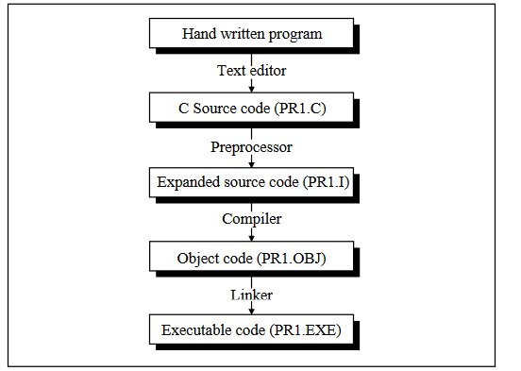

Slide 6
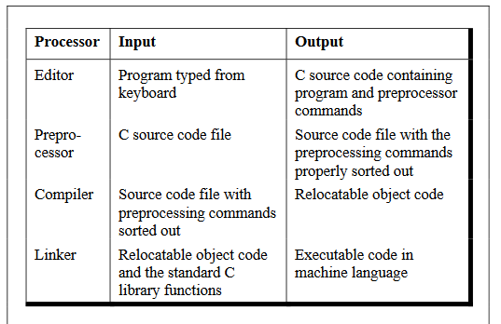

Slide 7
Macro Expansion
#define UPPER 25
main( )
{
int i ;
for ( i = 1 ; i <= UPPER ; i++ )
printf ( "\n%d", i ) ;
}
In this program instead of writing 25 in the for loop we are writing it in the form of UPPER, which has already been defined before main( ) through the statement,
#define UPPER 25
This statement is called ‘macro definition’ or more commonly, just a ‘macro’.

Slide 8
#define PI 3.1415
main( )
{
float r = 6.25 ;
float area ;
area = PI * r * r ;
printf ( "\nArea of circle = %f", area ) ;
}

Slide 9
File Inclusion
The preprocessor command for file inclusion looks like
this:
#include "filename“
and it simply causes the entire contents of filename to be inserted into the source code at that point in the program.
It can be used in two cases:
1. These files are
#included at the beginning of main program file
2. There are some functions and some macro definitions that we need almost in all programs that we write.

Slide 10
Actually there exist two ways to write #include statement. These
are:
#include "filename"
#include <filename>
The meaning of each of these forms is given below:
#include "goto.c"
This command would look for the file goto.c
in the current directory as well as the
specified list of directories as mentioned in
the include search path that might have been
set up.
#include <goto.c>
This command would look for the file goto.c
in the specified list of directories only

Slide 11
Conditional Compilation
The preprocessing commands
#ifdef and
#endif
which have the general form:
#ifdef macroname
statement 1 ;
statement 2 ;
statement 3 ;
#endif

Slide 12
Therefore the solution is to use conditional compilation as
shown below.
main( )
{
#ifdef OKAY
statement 1 ;
statement 2 ; /* detects virus */
statement 3 ;
statement 4 ; /* specific to stone virus */
#endif
statement 5 ;
statement 6 ;
statement 7 ;
}

Slide 13
#if and #elif Directives
The #if directive can be used to test whether an expression evaluates to a nonzero value or not.
If the result of the expression is nonzero, then subsequent lines upto a #else, #elif or #endif are compiled, otherwise they are skipped.

Slide 14
A simple example of #if directive is shown below:
main( )
{
#if TEST <= 5
statement 1 ;
statement 2 ;
statement 3 ;
#else
statement 4 ;
statement 5 ;
statement 6 ;
#endif
}

Slide 15
An example that uses such directives is shown below.
#if ADAPTER == VGA
code for video graphics array
#else
#if ADAPTER == SVGA
code for super video graphics array
#else
code for extended graphics adapter
#endif
#endif

Slide 16
Arrays
A set of similar data types, called array.
In such a case we have two options to store these marks in memory.
(a)
(b)
Construct 100 variables to store percentage marks obtained by 100 different students,
i.e. each variable containing one student’s marks.
Construct one variable (called array or subscripted variable) capable of storing or holding all the hundred values.

Slide 17
A Simple Program Using Array
main( )
{
int avg, sum = 0 ;
int i ;
int marks[30] ; /* array declaration */
for ( i = 0 ; i <= 29 ; i++ )
{
printf ( "\nEnter marks " ) ;
scanf ( "%d", &marks[i] ) ; /* store data in array */
}
for ( i = 0 ; i <= 29 ; i++ )
sum = sum + marks[i] ; /* read data from an array*/
avg = sum / 30 ;
printf ( "\nAverage marks = %d", avg ) ;
}

Slide 18
Array Declaration
In our program we have done this with the
Statement
int marks[30] ;
Here, int specifies the type of the variable, just as it does with ordinary variables and the word marks specifies the name of the variable.
The [30] however is new. The number 30 tells how many
elements of the type int will be in our array. This number is often called the ‘dimension’ of the array. The bracket ( [ ] ) tells the compiler that we are dealing with an array.

Slide 19
Accessing Elements of an Array
All the array elements are numbered, starting with 0.
Thus, marks[2] is not the second element of the array, but the third.
In our program we are using the variable i as a subscript to refer to various elements of the array.
This variable can take different values and hence can refer to the different elements in the array in turn.
This ability to use variables as subscripts is what makes arrays so useful.

Slide 20
Entering Data into an Array
Here is the section of code that places data into an array:
for ( i = 0 ; i <= 29 ; i++ )
{
printf ( "\nEnter marks " ) ;
scanf ( "%d", &marks[i] ) ;
}

Slide 21
The for loop causes the process of asking for and receiving a
student’s marks from the user to be repeated 30 times.
The first time through the loop, i has a value 0, so the scanf( ) function will cause the value typed to be stored in the array element marks[0],the first element of the array.
This process will be repeated until I 274 Let Us C becomes 29. This is last time through the loop, which is a good thing, because there is no array element like marks[30].
In scanf( ) function, we have used the “address of” operator (&) on
the element marks[i] of the array, just as we have used it earlier
on other variables (&rate, for example).
In so doing, we are passing the address of this particular array element to the scanf( ) function, rather than its value; which is what scanf( ) requires.

Slide 22
Reading Data from an Array
The for loop is much the same,but now the body of the loop causes each student’s marks to be added to a running total stored in a variable called sum.
When all the marks have been added up, the result is divided by 30, the number of students, to get the average.
for ( i = 0 ; i <= 29 ; i++ )
sum = sum + marks[i] ;
avg = sum / 30 ;
printf ( "\nAverage marks = %d", avg )

Slide 23
To fix our ideas, let us revise whatever we have learnt about
arrays:
(a) An array is a collection of similar elements.
(b) The first element in the array is numbered 0, so the last
element is 1 less than the size of the array.
(c) An array is also known as a subscripted variable.
(d) Before using an array its type and dimension must be
declared.
(e)However big an array its elements are always stored in
contiguous memory locations. This is a very important point
which we would discuss in more detail later on.

Slide 24
More on Arrays
Array is a very popular data type with C programmers. This is because of the convenience with which arrays lend themselves to programming.
Array Initialisation
Following are a few examples that demonstrate this.
int num[6] = { 2, 4, 12, 5, 45, 5 } ;
int n[ ] = { 2, 4, 12, 5, 45, 5 } ;
float press[ ] = { 12.3, 34.2 -23.4, -11.3 } ;

Slide 25
Note the following points carefully:
(a) Till the array elements are not given any specific values, they are supposed to contain garbage values.
(b) If the array is initialised where it is declared, mentioning the dimension of the array is optional as in the 2nd example above.

Slide 26
Array Elements in Memory
Consider the following array declaration:
int arr[8]
16 bytes get immediately reserved in memory, 2 bytes each for the 8 integers (under Windows/Linux the array would occupy 32 bytes

Slide 28
Passing Array Elements to a Function
Array elements can be passed to a function by calling the function by value, or by reference.
In the call by value we pass values of
array elements to the function, whereas in the call by reference we pass addresses of array elements to the function.

Slide 29
/* Demonstration of call by value */
main( )
{
int i ;
int marks[ ] = { 55, 65, 75, 56, 78, 78, 90 } ;
for ( i = 0 ; i <= 6 ; i++ )
display ( marks[i] ) ;
}
display ( int m )
{
printf ( "%d ", m ) ;
}
And here’s the output...
55 65 75 56 78 78 90

Slide 30
Passing Array Elements to a Function
Array elements can be passed to a function by calling the function by value, or by reference.
In the call by value we pass values of array elements to the function, whereas in the call by reference we pass addresses of array elements to the function.
These two calls are illustrated below:

Slide 31
/* Demonstration of call by value */
main( )
{
int i ;
int marks[ ] = { 55, 65, 75, 56, 78, 78, 90 } ;
for ( i = 0 ; i <= 6 ; i++ )
display ( marks[i] ) ;
}
display ( int m )
{
printf ( "%d ", m ) ;
}
And here’s the output...
55 65 75 56 78 78 9

Slide 32
And now the call by reference.
/* Demonstration of call by reference */
main( )
{
int i ;
int marks[ ] = { 55, 65, 75, 56, 78, 78, 90 } ;
for ( i = 0 ; i <= 6 ; i++ )
disp ( &marks[i] ) ;
}
disp ( int *n )
{
printf ( "%d ", *n ) ;
}
And here’s the output...
55 65 75 56 78 78 90

Slide 33
Pointers and Arrays..
main( )
{
int i = 3, *x ;
float j = 1.5, *y ;
char k = 'c', *z ;
printf ( "\nValue of i = %d", i ) ;
printf ( "\nValue of j = %f", j ) ;
printf ( "\nValue of k = %c", k ) ;
x = &i ;
y = &j ;
z = &k ;
printf ( "\nOriginal address in x = %u", x ) ;
printf ( "\nOriginal address in y = %u", y ) ;
printf ( "\nOriginal address in z = %u", z ) ;
x++ ;
y++ ;
z++ ;
printf ( "\nNew address in x = %u", x ) ;
printf ( "\nNew address in y = %u", y ) ;
printf ( "\nNew address in z = %u", z ) ;
}
Here is the output of the program.
Value of i = 3
Value of j = 1.500000
Value of k = c
Original address in x = 65524
Original address in y = 65520
Original address in z = 65519
New address in x = 65526
New address in y = 65524
New address in z = 65520

Slide 34
Two Dimensional Arrays
The two-dimensional array is also called a matrix.
Here is a sample program that stores roll number and marks obtained by a student side by side in a matrix.
main( )
{
int stud[4][2] ;
int i, j ;
for ( i = 0 ; i <= 3 ; i++ )
{
printf ( "\n Enter roll no. and marks" ) ;
scanf ( "%d %d", &stud[i][0], &stud[i][1] ) ;
}
for ( i = 0 ; i <= 3 ; i++ )
printf ( "\n%d %d", stud[i][0], stud[i][1] ) ;
}

Slide 35
Look at the scanf( ) statement used in the first for loop:
scanf ( "%d %d", &stud[i][0], &stud[i][1] )
In stud[i][0] and stud[i][1] the first subscript of the variable stud,is row number which changes for every student.
The second subscript tells which of the two columns are we talking about—the zeroth column which contains the roll no. or the first column
which contains the marks.

Slide 36
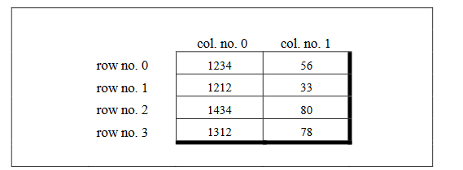

Slide 37
Array of Pointers
The way there can be an array of ints or an array of floats,similarly there can be an array of pointers.
Since a pointer variable always contains an address, an array of pointers would be nothing but a collection of addresses.

Slide 38
main( )
{
int *arr[4] ; /* array of integer pointers */
int i = 31, j = 5, k = 19, l = 71, m ;
arr[0] = &i ;
arr[1] = &j ;
arr[2] = &k ;
arr[3] = &l ;
for ( m = 0 ; m <= 3 ; m++ )
printf ( "%d ", * ( arr[m] ) ) ;
}

Slide 39
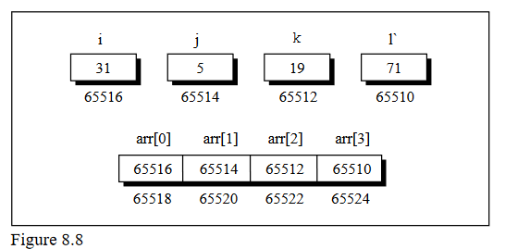

Slide 40
An array of pointers can even contain the addresses of other arrays.
The following program would justify this.
main( )
{
static int a[ ] = { 0, 1, 2, 3, 4 } ;
int *p[ ] = { a, a + 1, a + 2, a + 3, a + 4 } ;
printf ( "\n%u %u %d", p, *p, * ( *p ) ) ;
}

Slide 41
Three-Dimensional Array
We aren’t going to show a programming example that uses a three-dimensional array.
This is because, in practice, one rarely uses this array.
However, an example of initializing a three-dimensional array will consolidate your understanding of subscripts:

Slide 42
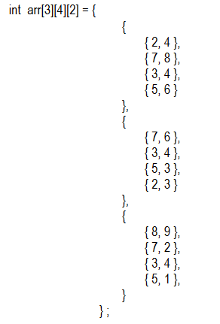

Slide 43
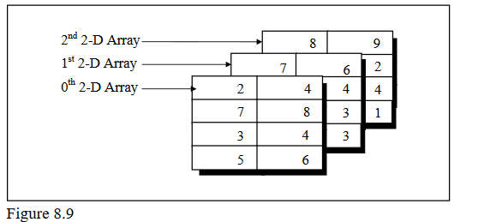

Slide 44
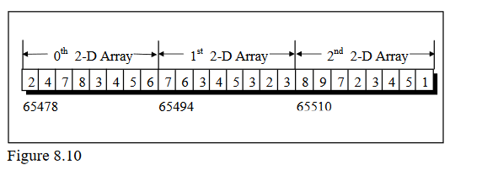
Again remember that the arrangement shown above is only conceptually true.
In memory the same array elements are stored linearly as shown in Figure 8.10

Slide 45
We can therefore say that the element 1 can be referred as arr[2][3][1].
It may be noted here that the counting of array elements even for a 3-D array begins with
zero.
For example, the following two expressions refer to the same element in the 3-D array:
arr[2][3][1]
*( *( *( arr + 2 ) + 3 ) + 1 )

